Slide 1






TILE BREAKER
24780: EngIneerIng ComputatIon
START!
d
TEAM : BUG LIFE

Slide 2
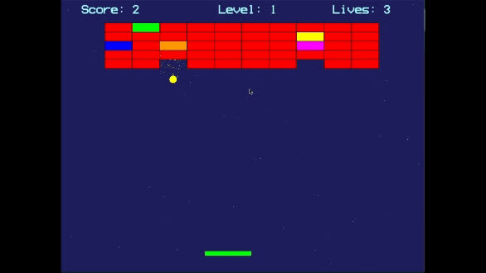
OvervIew

Slide 3
RenderIng, AudIo & PhysIcs:
Ball, Paddle, TIle, Sound, ExplodIng PartIcles, Background, CollIsIon Checks
Program Flow
Classes for game object
Sparsh
NIshanth
MaIn:
Call other modules, InItIalIzatIon, Scores and LIves
User prompts &
InformatIon
Current Game state
Power Ups & Level Ups:
Player LIfe, Paddle WIdth, Ball Speed
FIle Management & Pause Screen:
InstructIon, Leaderboard, ExItIng, Resume, Restart
VasvI
TarIq
Updated game state

Slide 4
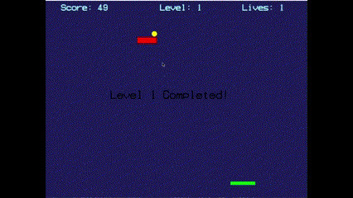
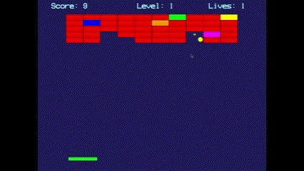
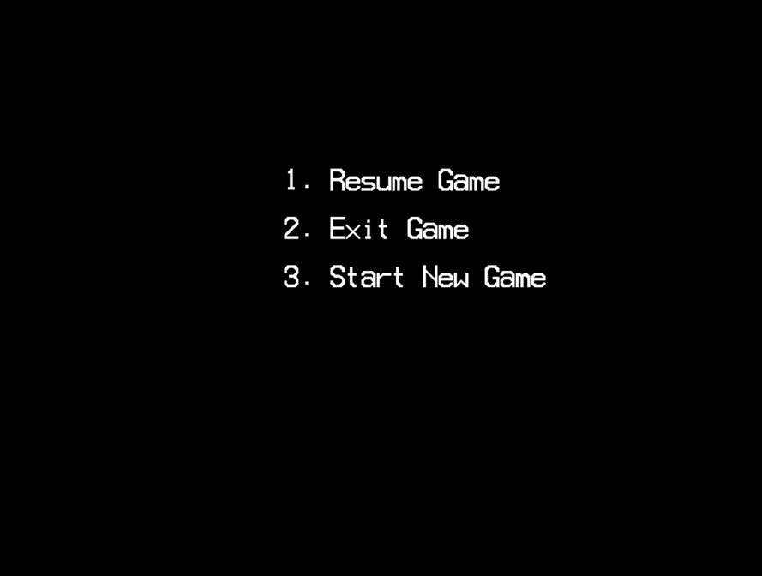
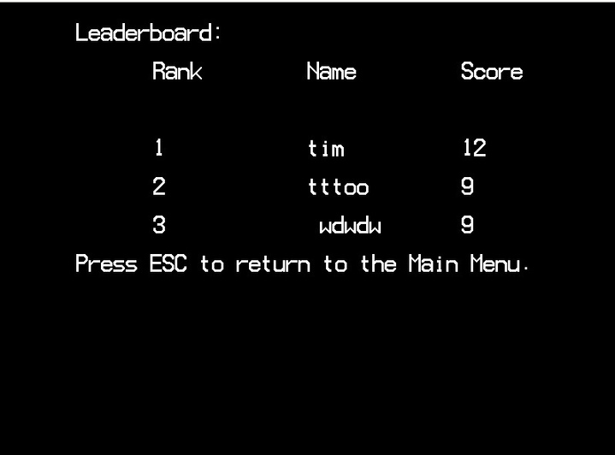
Complementary
Level Ups
Leader Board
Pause screen
Power ups

Slide 5
THANK YOU
CONTIBUTORS
SPARSH (SPARSHG)
VASVI (VASVIA)
TARIQ (TJAHEERH)
NISHANTH (NMOHANKU)
END

